Slide 1
pH Sensor Proposal
By:
Allan Yanggen, Emma Anderson, Austin Brummett

Slide 2
Project Overview
Our team decided to make a system where the pH of water in a certain area will be automatically measured and remotely accessible by the aquaponics class. We will have a system where, instead of testing the water manually, it will be possible to remotely have a sensor test the water and send that information back to the person. This system would make testing the water’s pH much less of a hassle, and with probable accuracy improvements to former pH testing methods.

Slide 3
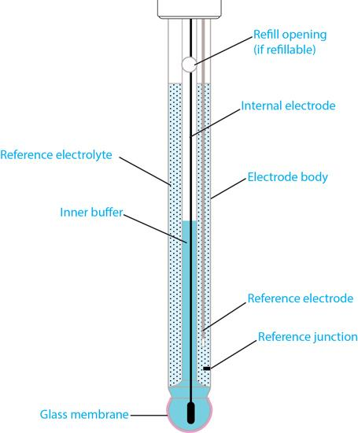
Buying a Sensor
$
$
Rather than building a pH sensor, our team decided it would be most efficient to purchase a professionally made product. Building a pH sensor would cost a lot of time and a lot of money; buying then constructing the individual pieces for said sensor would be way more work than necessary.
$
$
$
$
$
$

Slide 4
What pH Sensor to Buy?
Our team has found viable options for which pH sensor to buy. These ones in particular are good prices and they are professional grade.
https://www.alibaba.com/product-detail/Portable-Waterproof-Water-PH-meter-PH_60683305837.html
https://www.turtletough.com.au/product/ph-sensor-remote-monitoring/
https://www.pasco.com/prodCatalog/PS/PS-3204_wireless-ph-sensor/index.cfm

Slide 5
Thank You For Your Time

